Slide 1

Defense diploma thesis Daniel Fischer
Fakultät Maschinenwesen
Professur für Transportprozesse an Grenzflächen

Slide 2
Content
Introduction
Goemetric system
Governing equations
Mass- & momentum conservation
Energy equation
Reaction equation
Species distribution PDE system
Mesh dependency and validation
Simulation results
Limitations
Conclusion & Outlook

Slide 3
geometry
modelling plane
x
r
Radial geometry
Domain filled with reactant A
Reactant B injected radially into B
Axisymmetric assumption → 2D Case sufficient to model

Slide 4
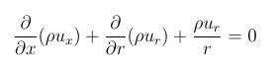
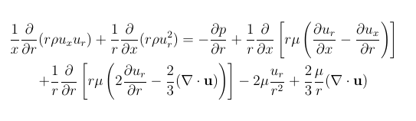
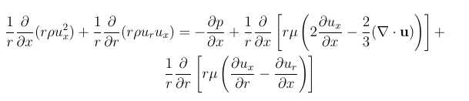
Governing equations
Mass conservation
Continuity equation
Momentum equations
Radial momentum equation
Axial momentum equation

Slide 5
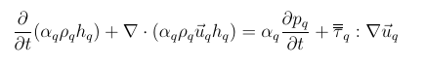
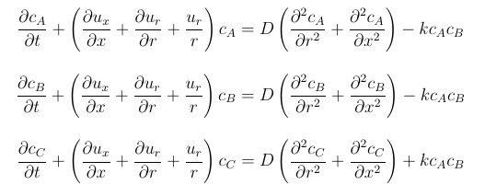
Governing equations
Energy equation
Species distribution equations

Slide 6
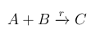
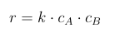
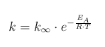
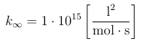
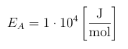
Governing equations
Reaction equation
Reaction rate
Reaction rate constant

Slide 7
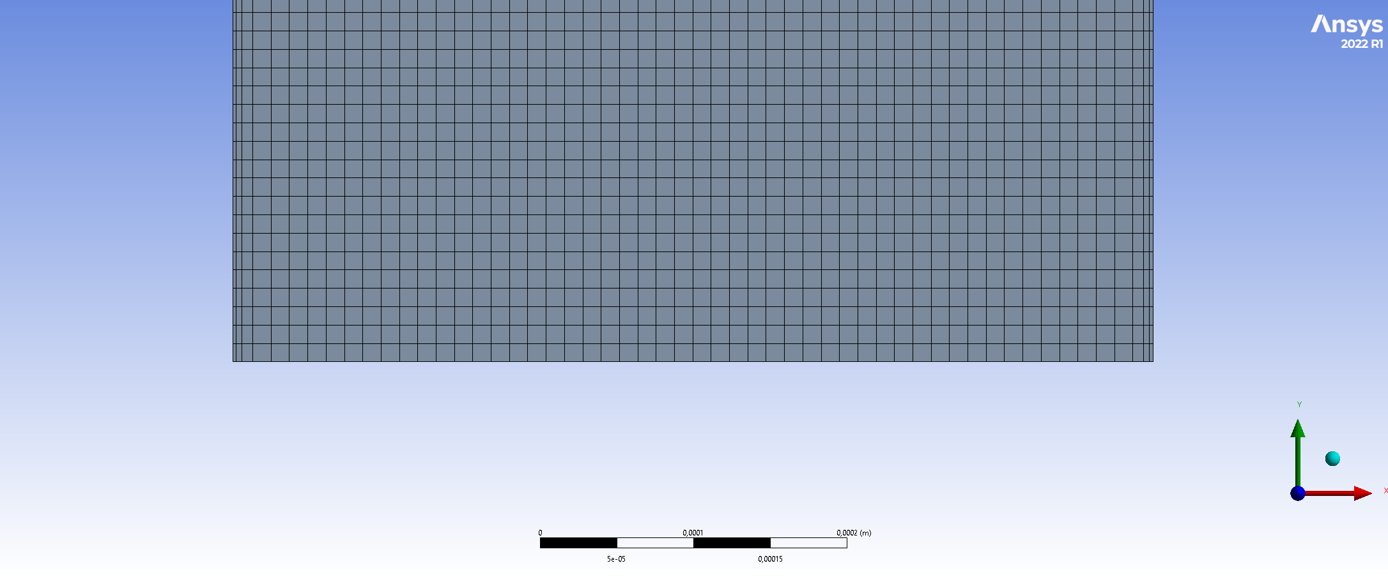
Mesh creation

Slide 8
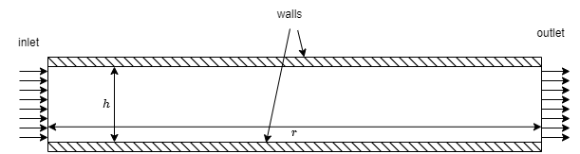
Boundary conditions
No slip
Inlet velocity magnitude
Pressure outlet

Slide 9
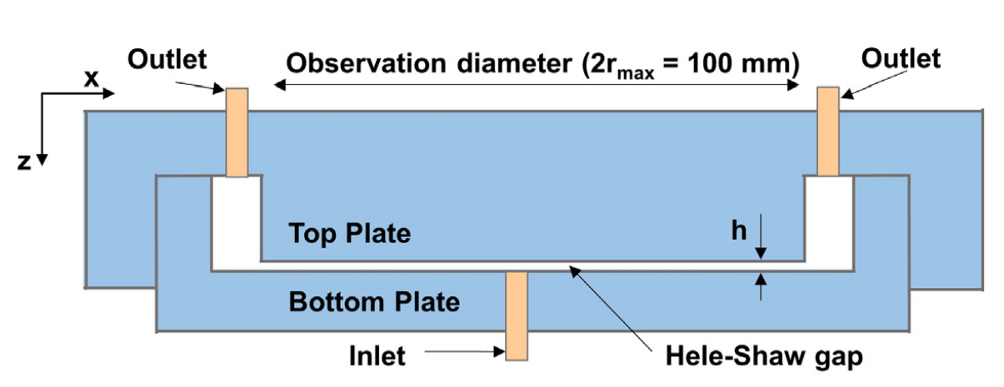
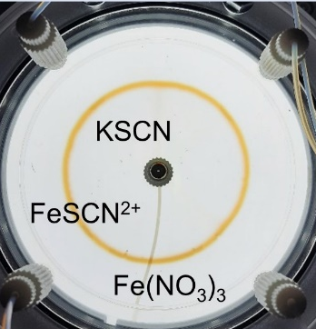
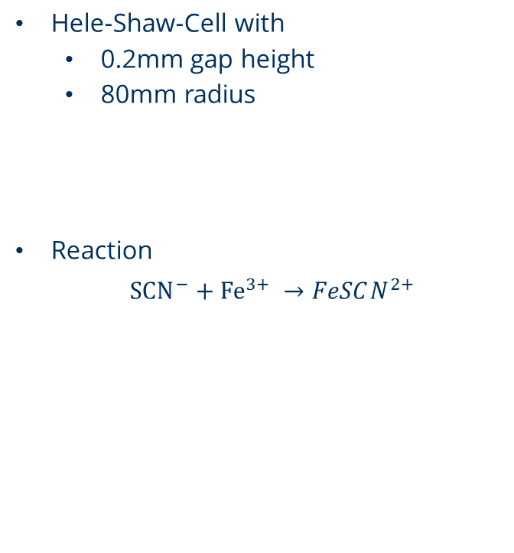
Experimental setup
Hele-Shaw-Cell with
0.2mm gap height
80mm radius
Reaction
${SCN}^{−}+{Fe}^{3+} →FeSCN^{2+}$

Slide 10
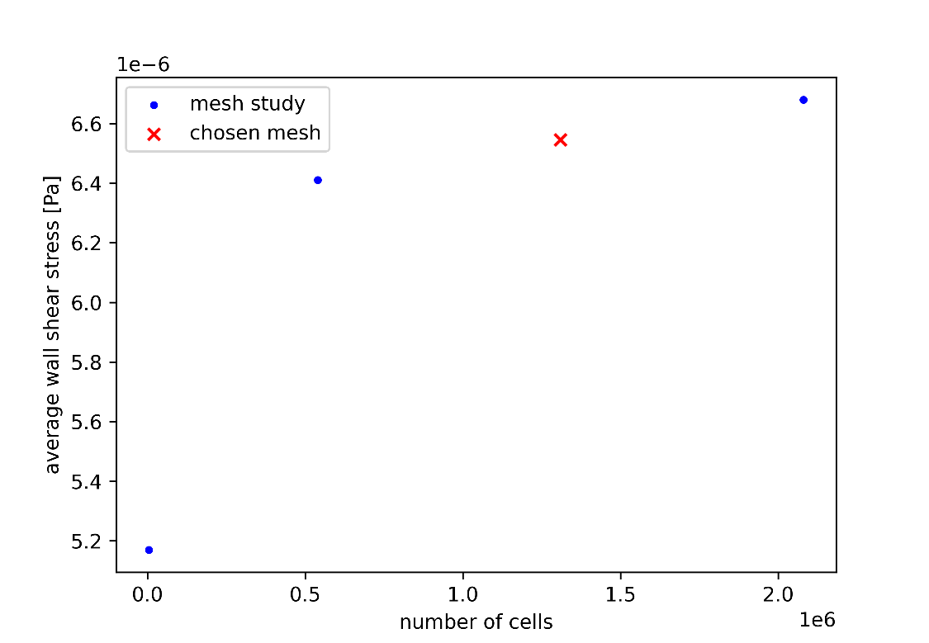
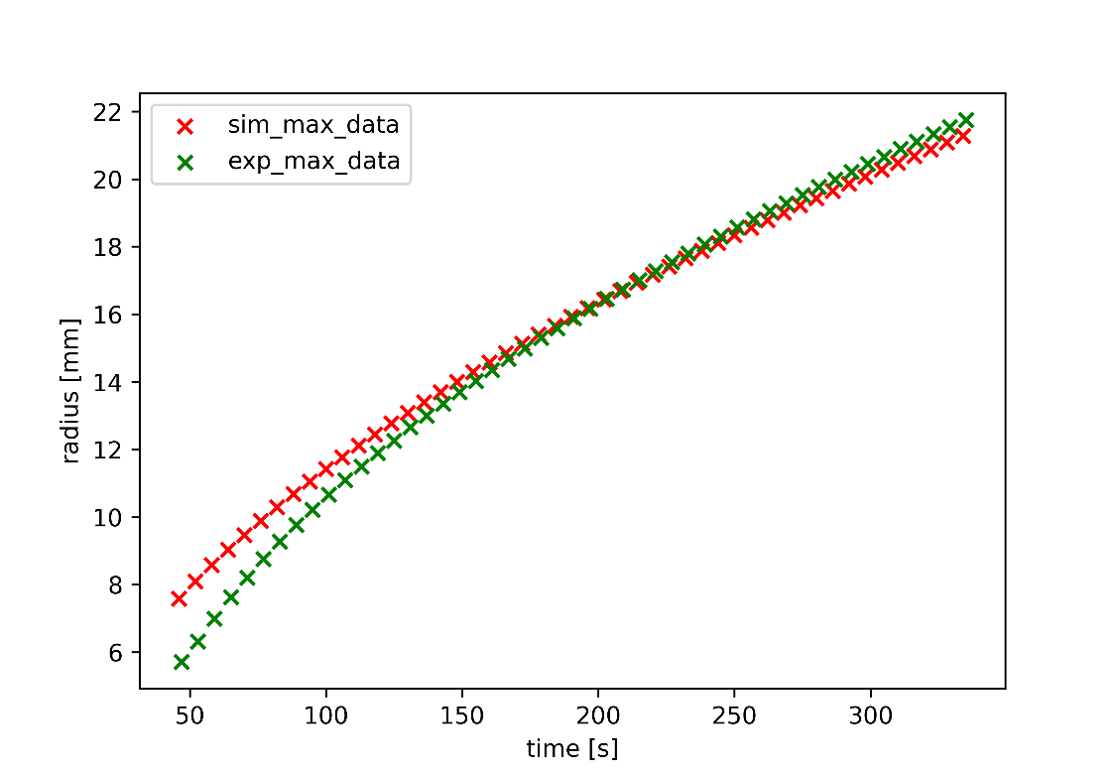
Mesh dependency and validation
Different mesh densities investigated
Validation against existing experimental data

Slide 11
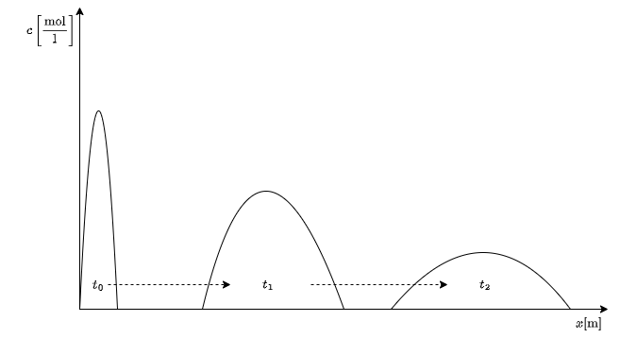
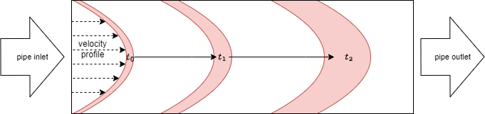
Taylor dispersion
Spreading in space and time
Spreading of a front within a pipe
Spreading of gap averaged values

Slide 12
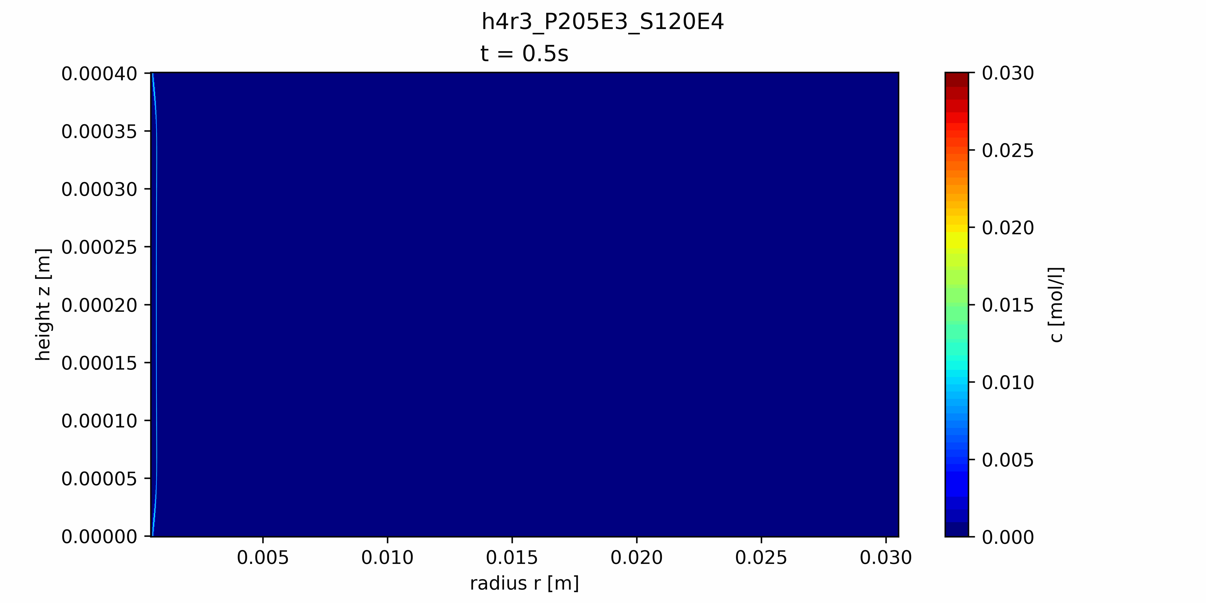
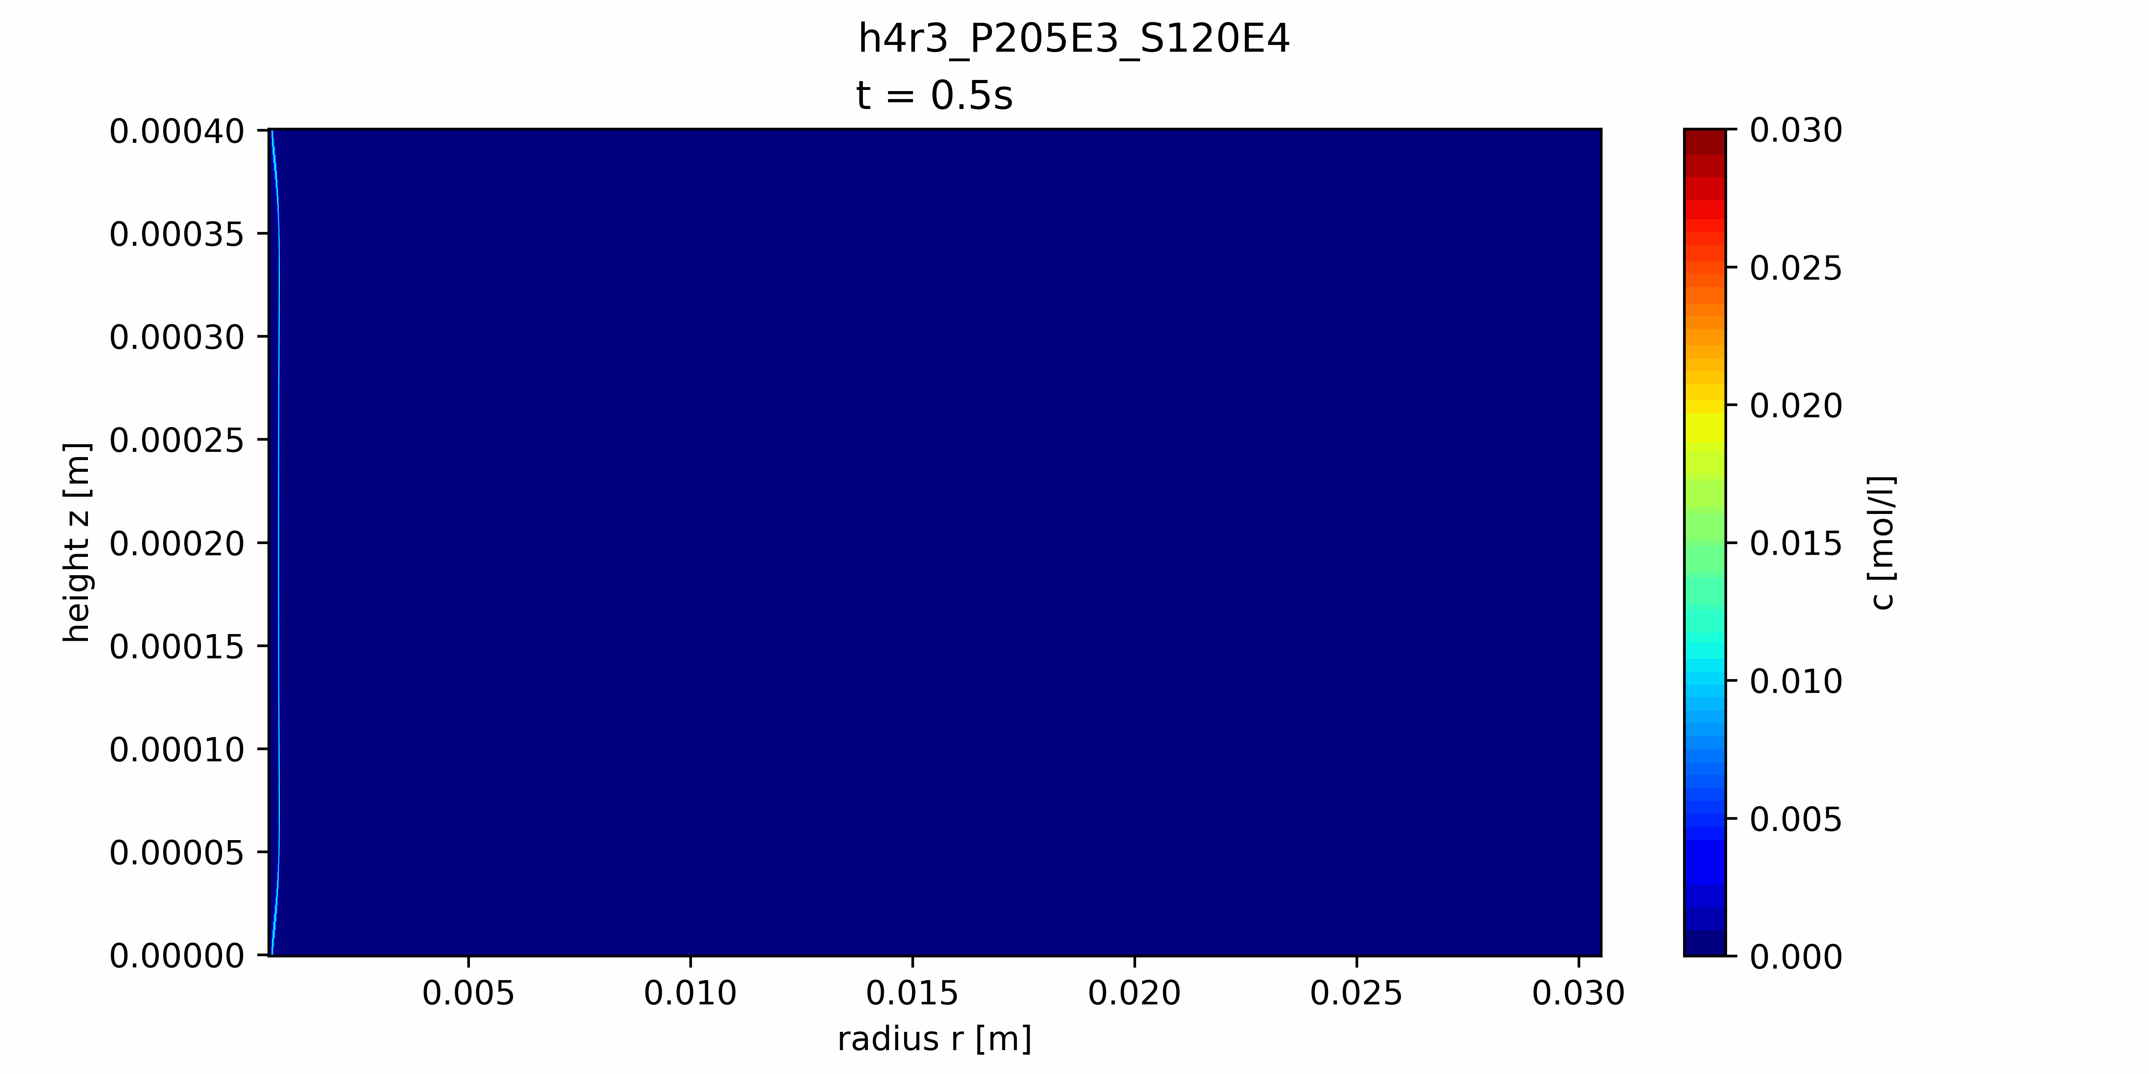
Results

Slide 13
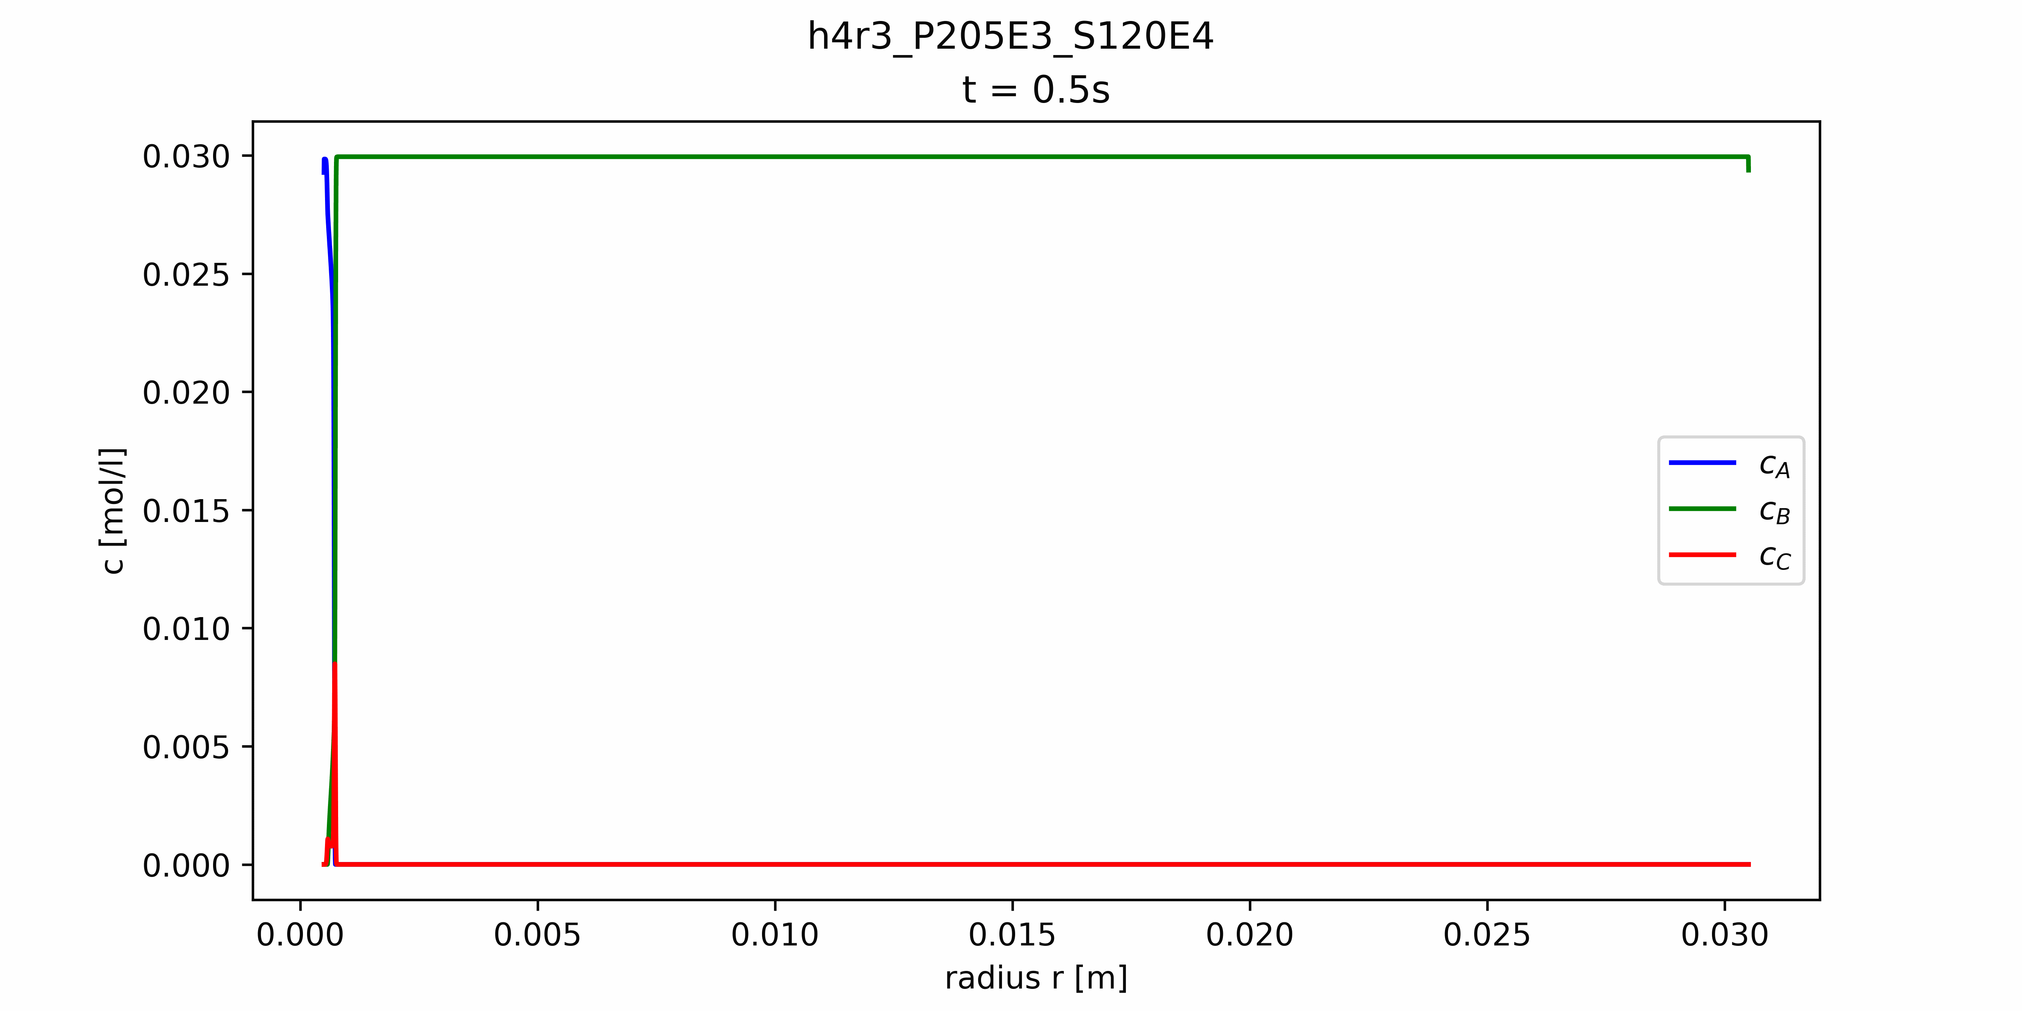

Results

Slide 14
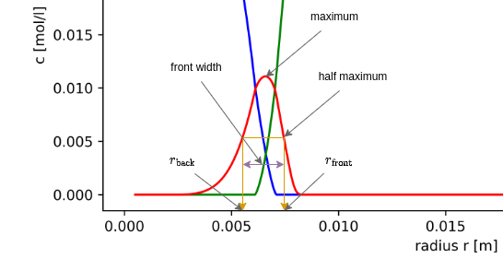
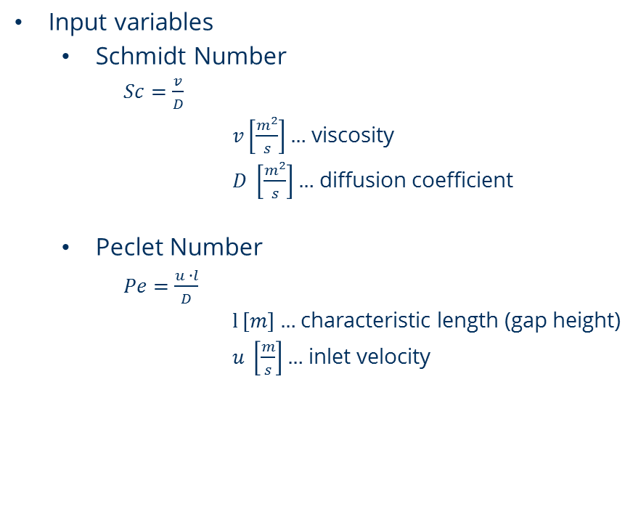
Parametric study
Input variables
Schmidt Number
$Sc=\frac{v}{D}$
$v\left[\frac{m^{2}}{s}\right]…$ viscosity
$D \left[\frac{m^{2}}{s}\right]…$ diffusion coefficient
Peclet Number
$Pe=\frac{u ∙l}{D}$
$l \left[m\right]…$ characteristic length (gap height)
$u \left[\frac{m}{s}\right]…$ inlet velocity
Investigated parameters
Fronts front & maximum positions
Front width
Total product formed

Slide 15
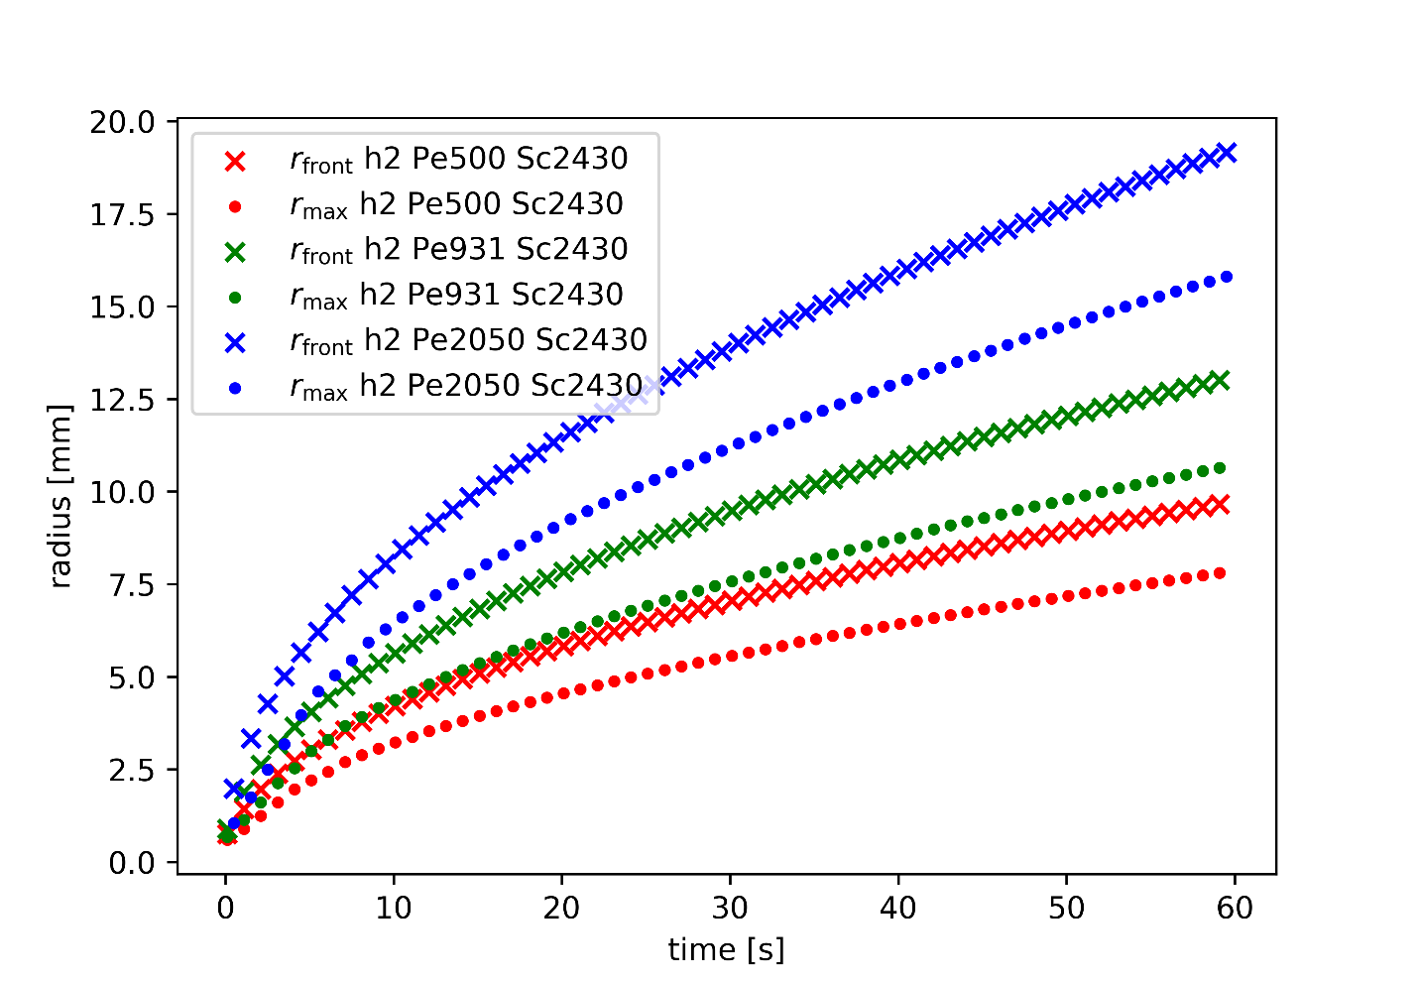
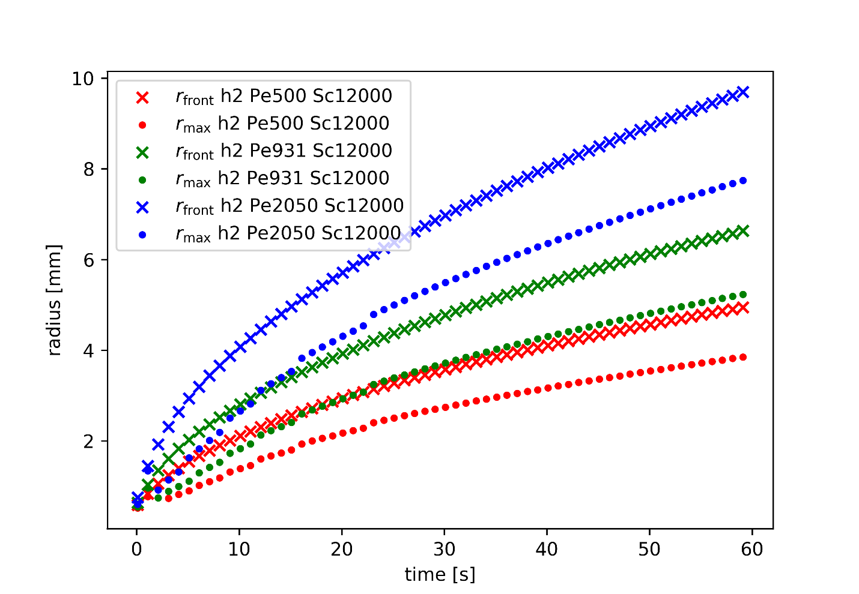
Front positions h = 0.2mm

Slide 16
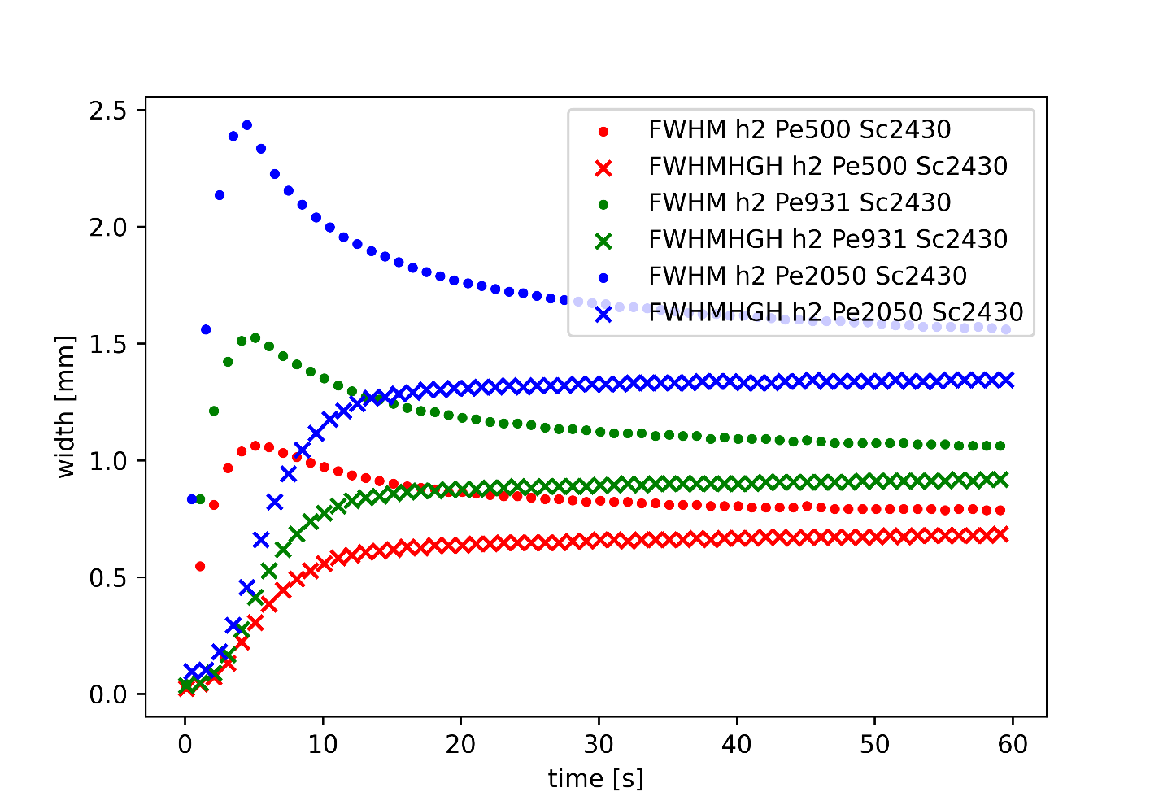
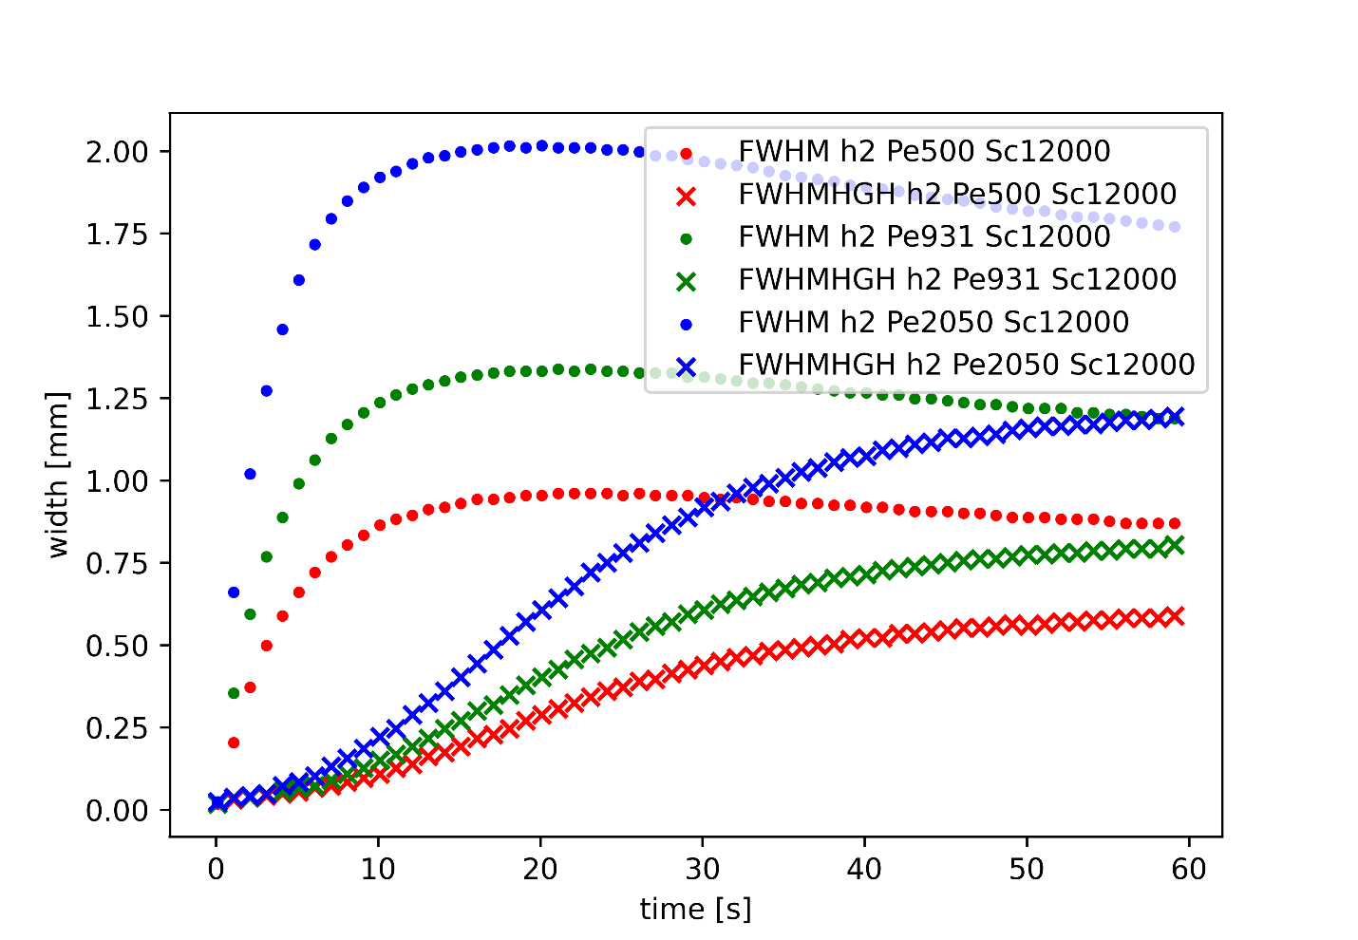
Front widths h = 0.2mm

Slide 17
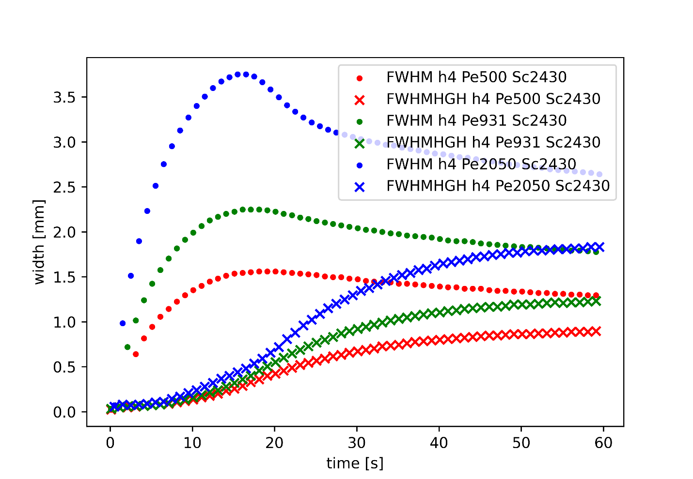
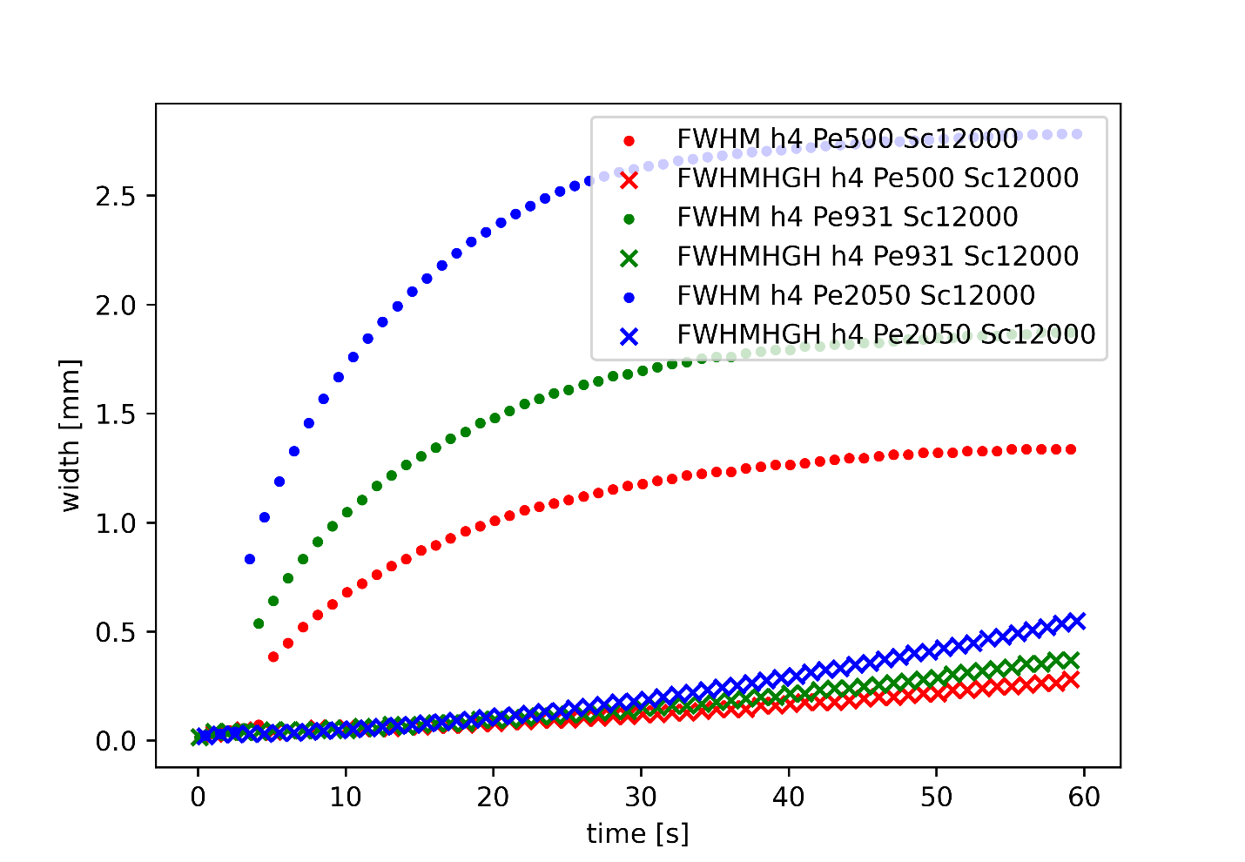
Front widths h = 0.4mm

Slide 18
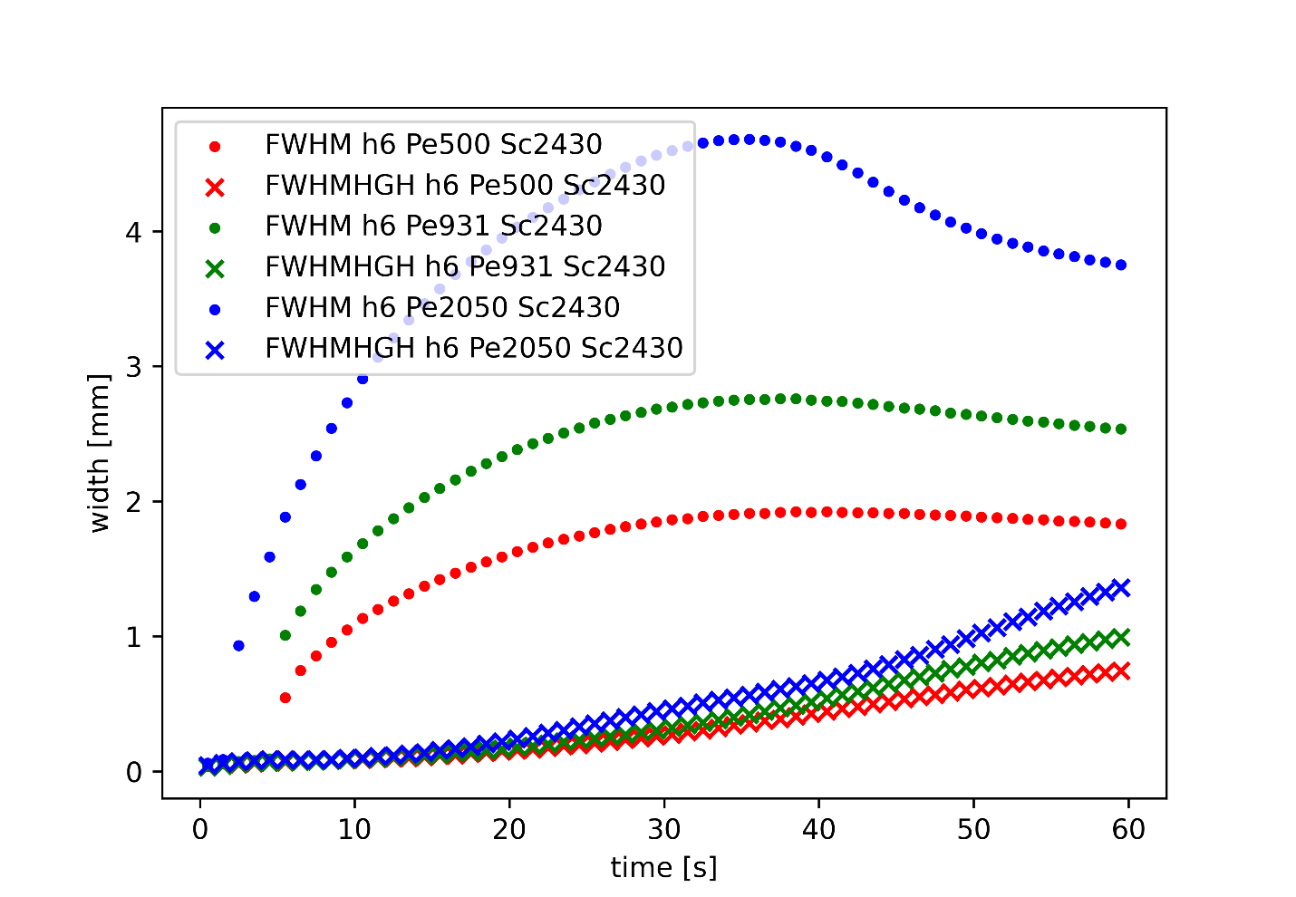
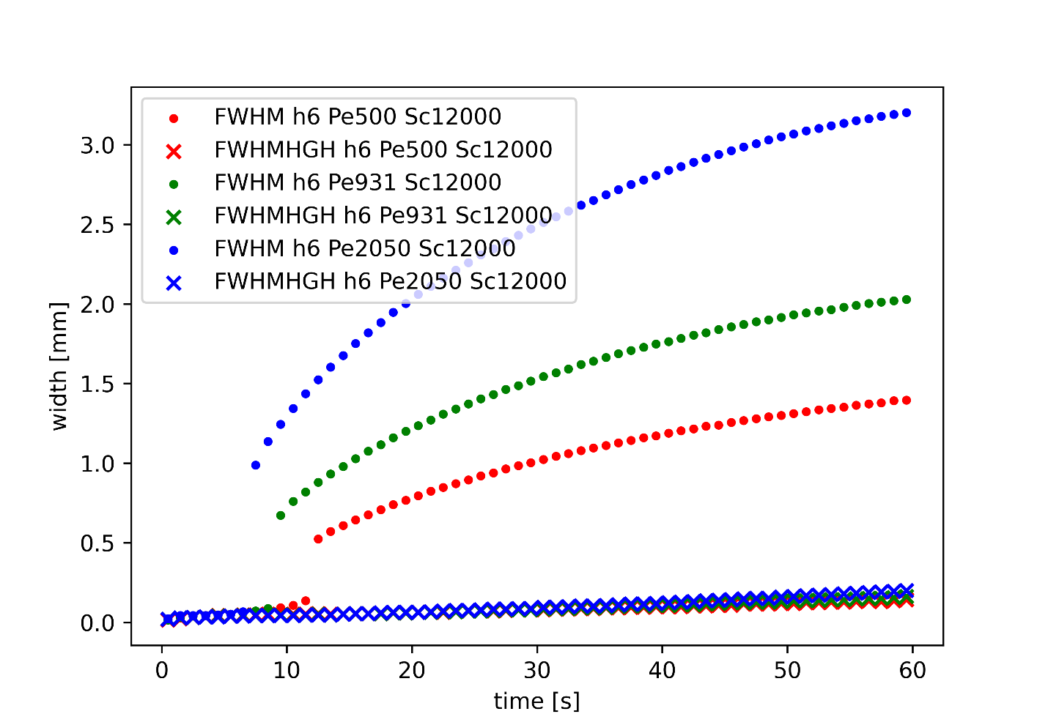
Front widths h = 0.6mm

Slide 19
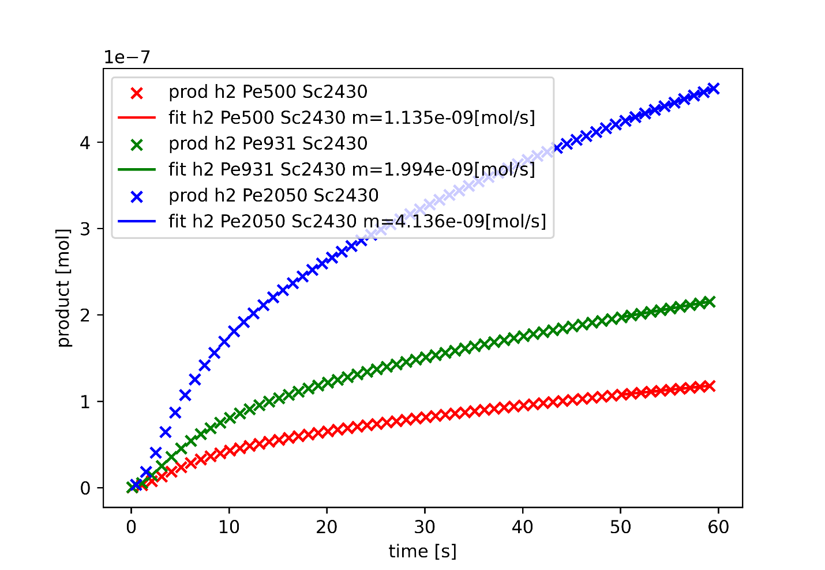
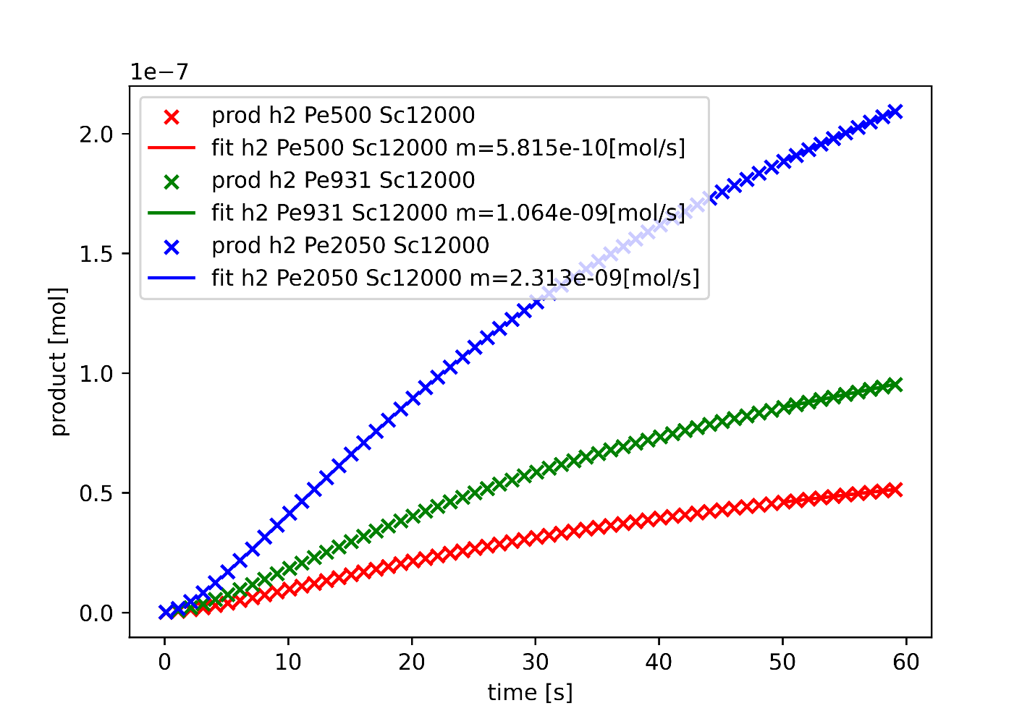
Total product formed h = 0.2mm

Slide 20
Limitations and Conclusion
Limitations
Conclusion

Slide 21
Thank you for attention

Slide 22
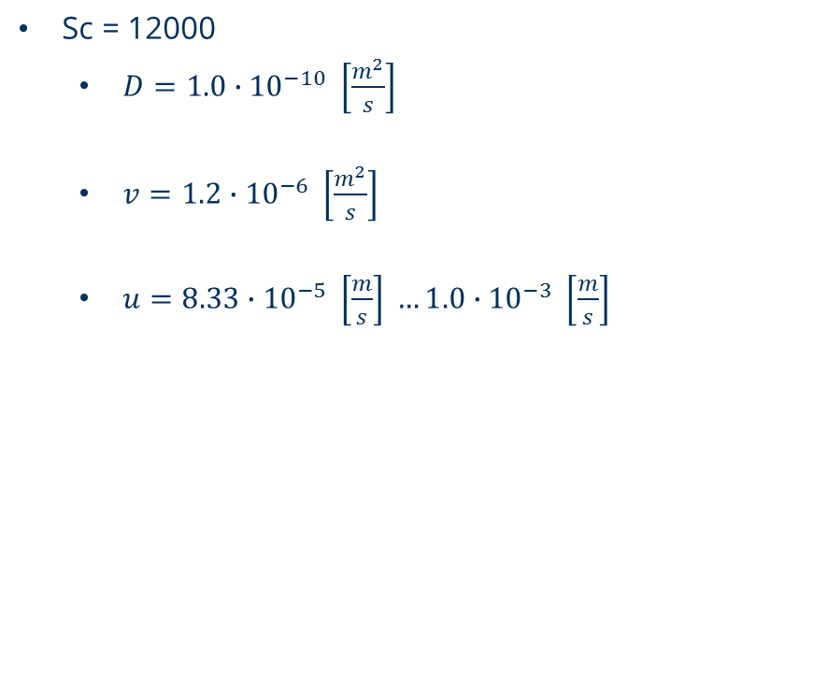
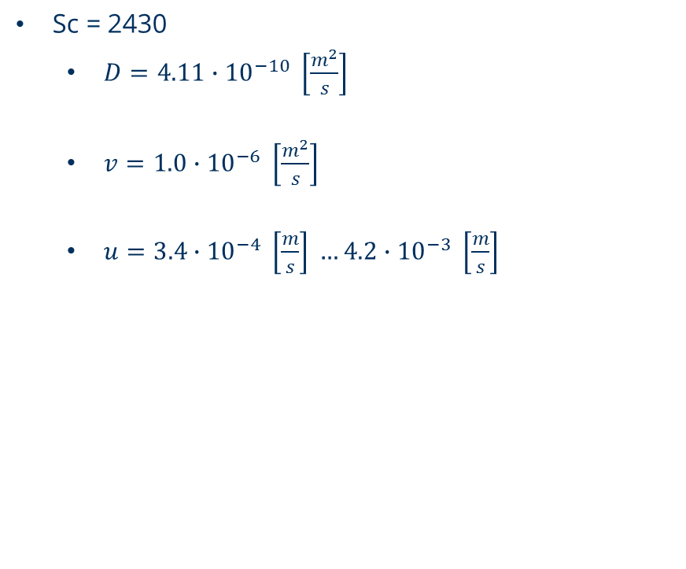
parameters
Sc = 2430
$D=4.11∙{10}^{−10} \left[\frac{m^{2}}{s}\right]$
$v=1.0∙{10}^{−6} \left[\frac{m^{2}}{s}\right]$
$u=3.4∙{10}^{−4} \left[\frac{m}{s}\right] …4.2∙{10}^{−3} \left[\frac{m}{s}\right]$
Sc = 12000
$D=1.0∙{10}^{−10} \left[\frac{m^{2}}{s}\right]$
$v=1.2∙{10}^{−6} \left[\frac{m^{2}}{s}\right]$
$u=8.33∙{10}^{−5} \left[\frac{m}{s}\right] …1.0∙{10}^{−3} \left[\frac{m}{s}\right]$

Slide 23
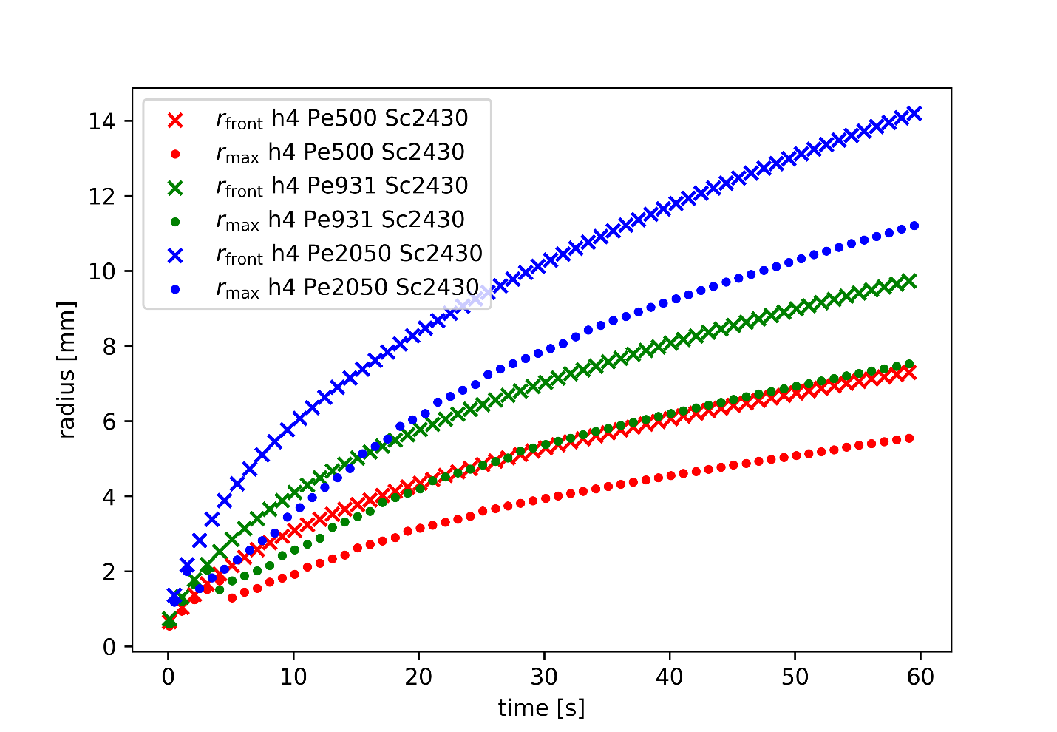
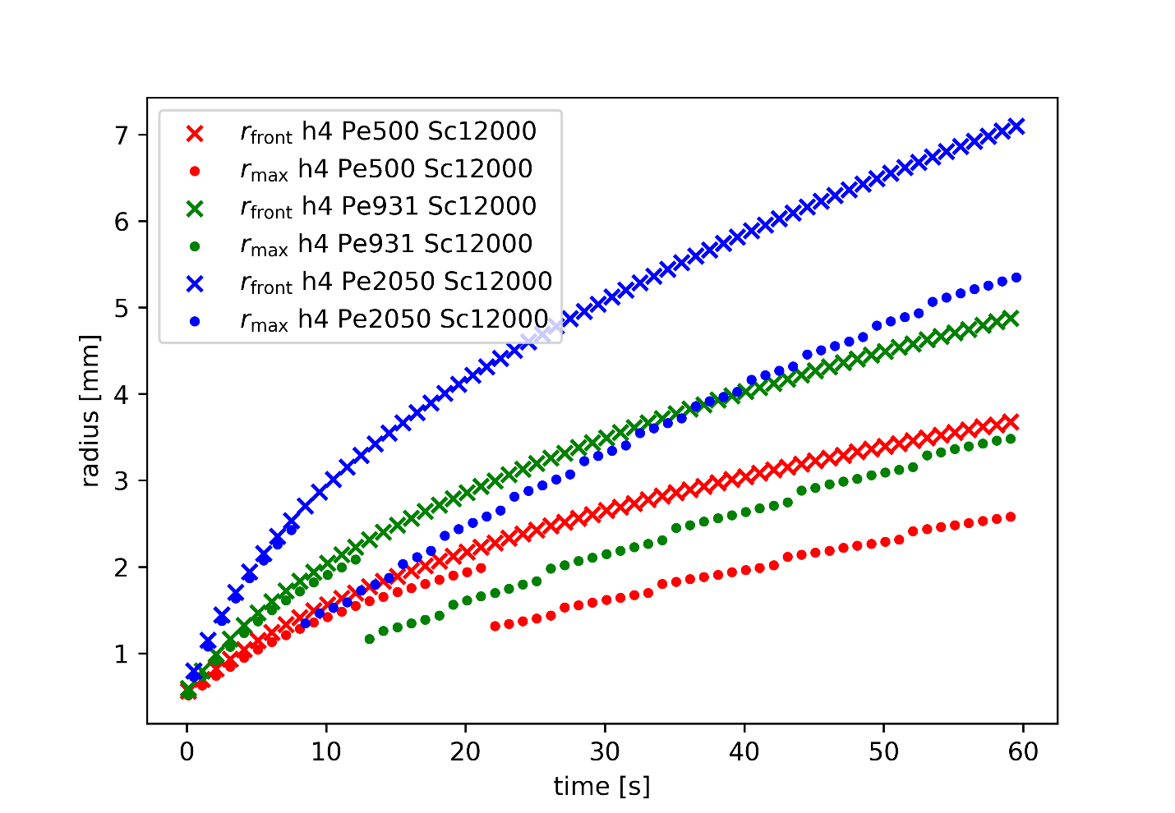
Front positions h = 0.4mm

Slide 24
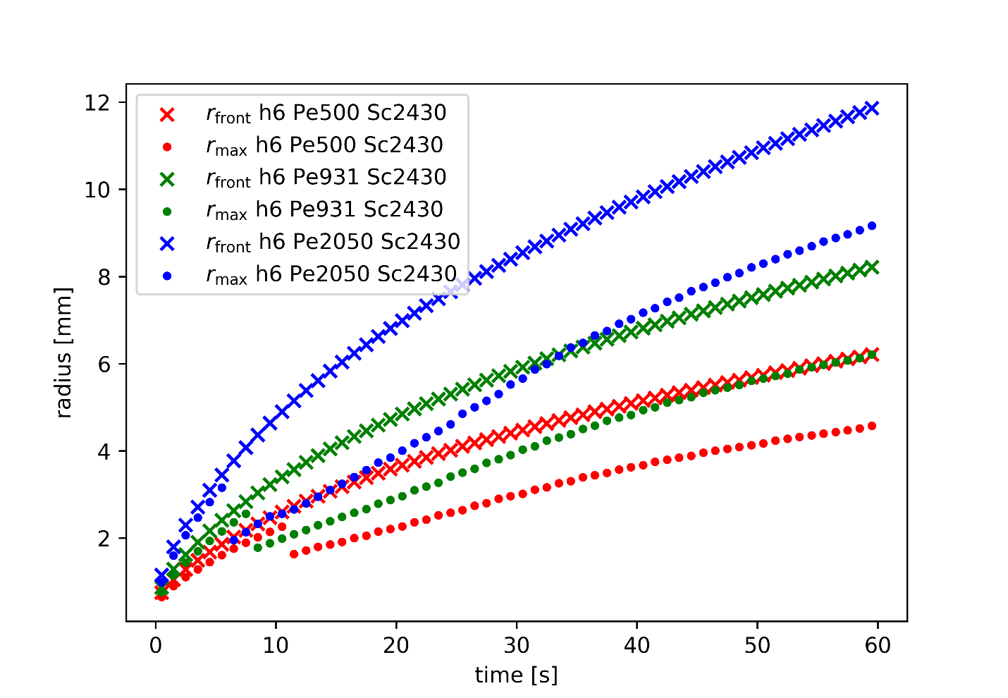
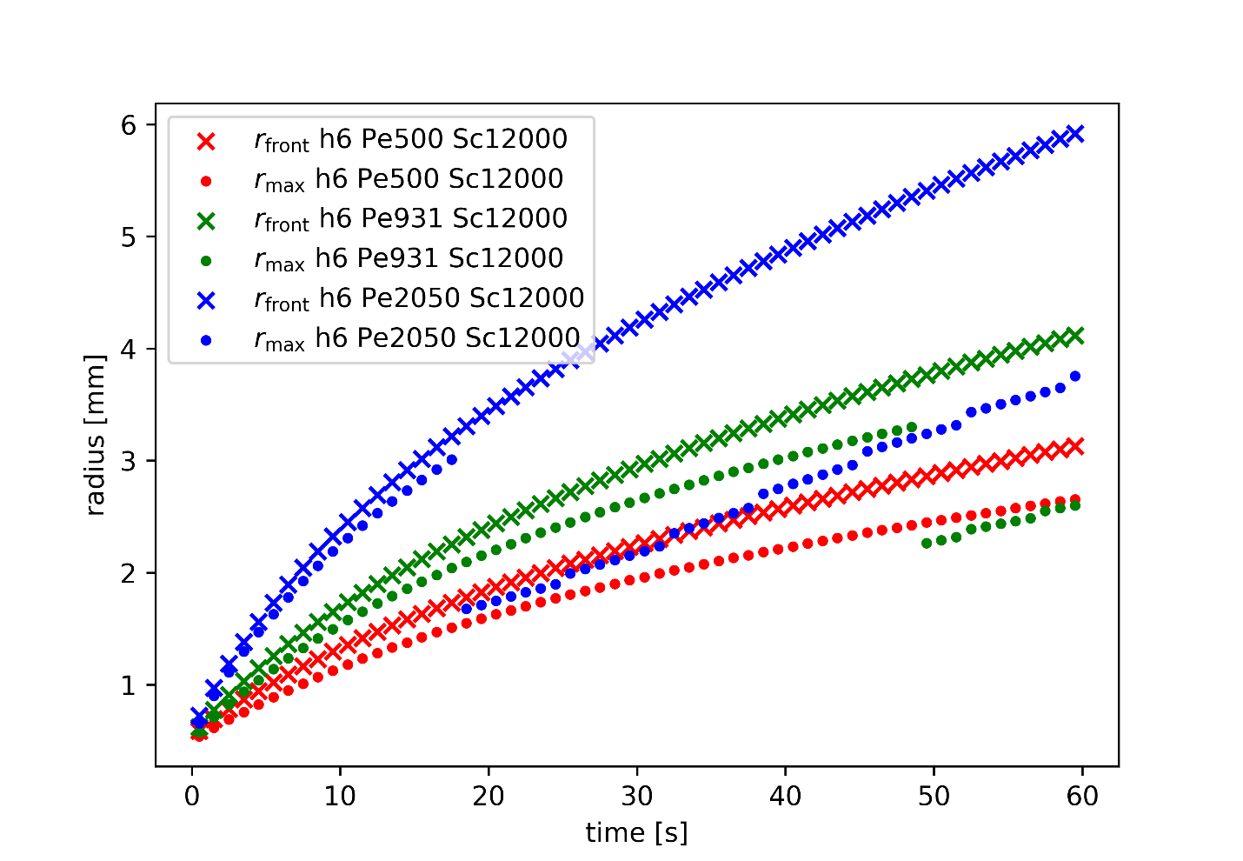
Front positions h = 0.6mm

Slide 25
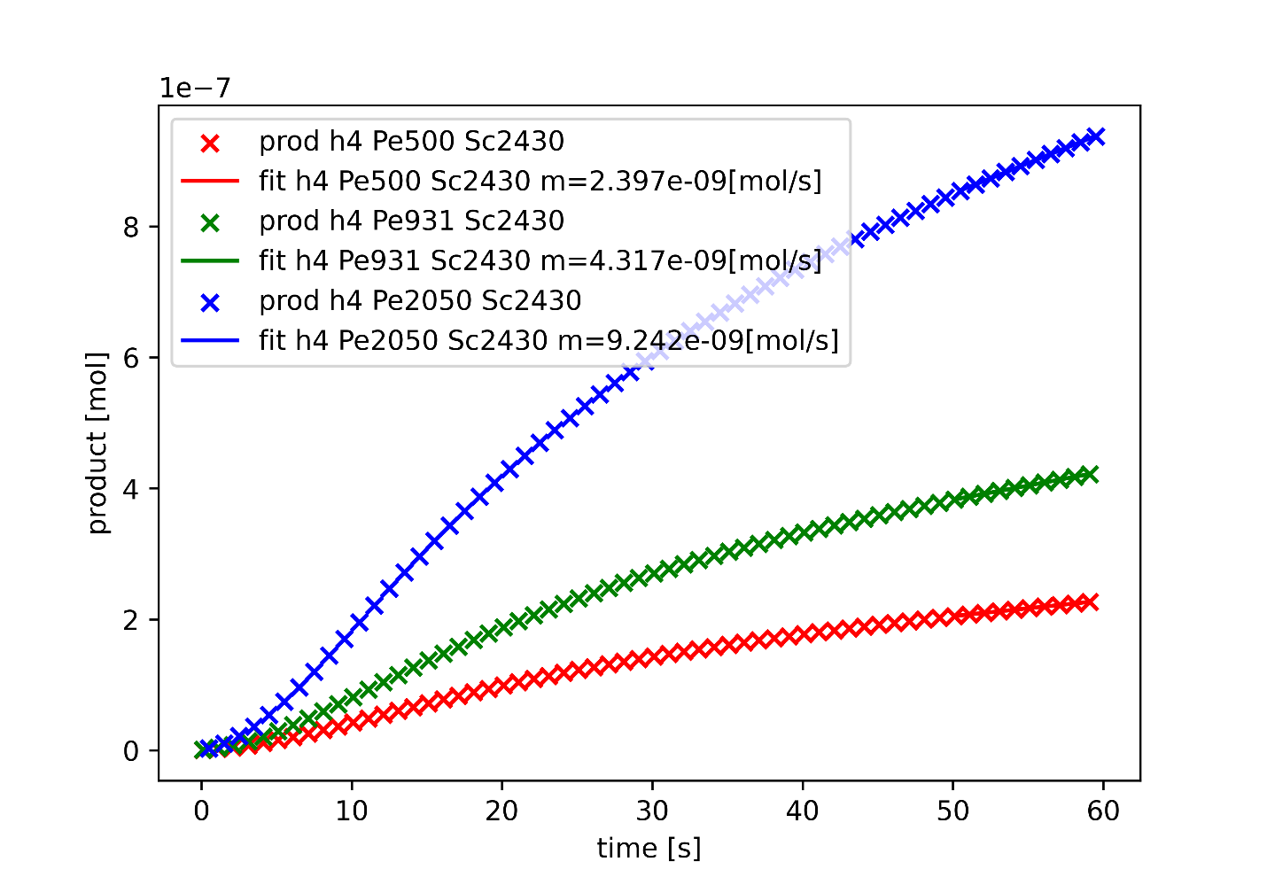
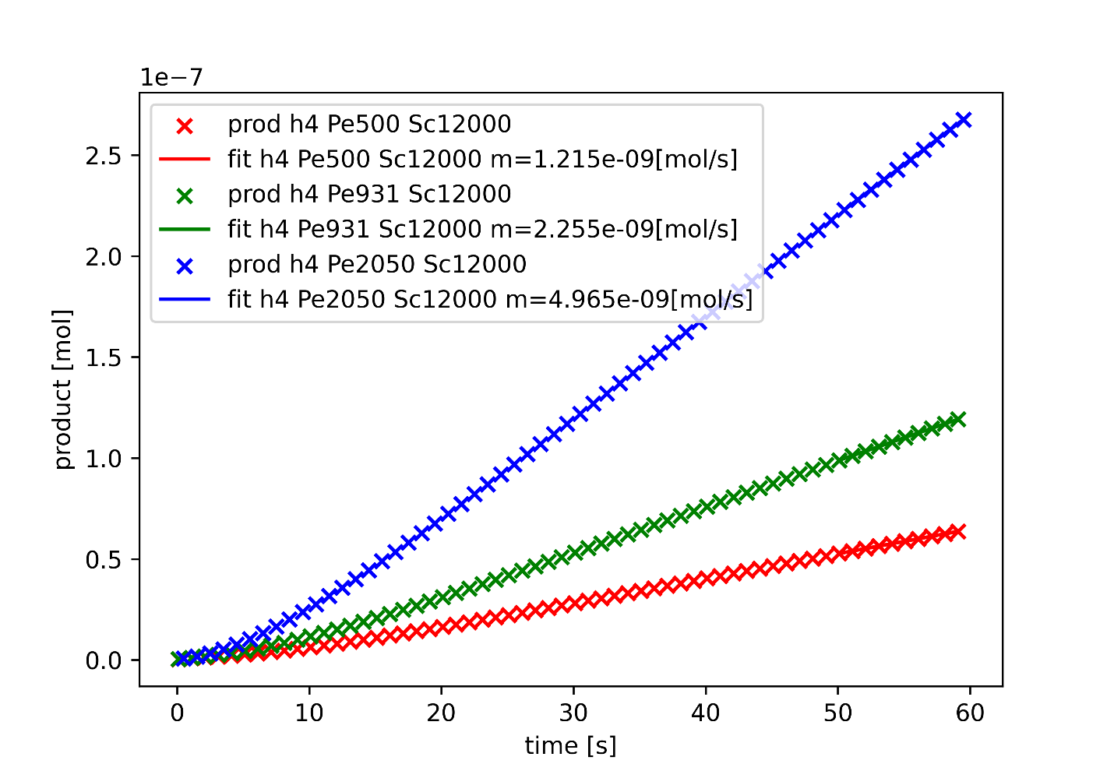
Total product formed h = 0.4mm

Slide 26
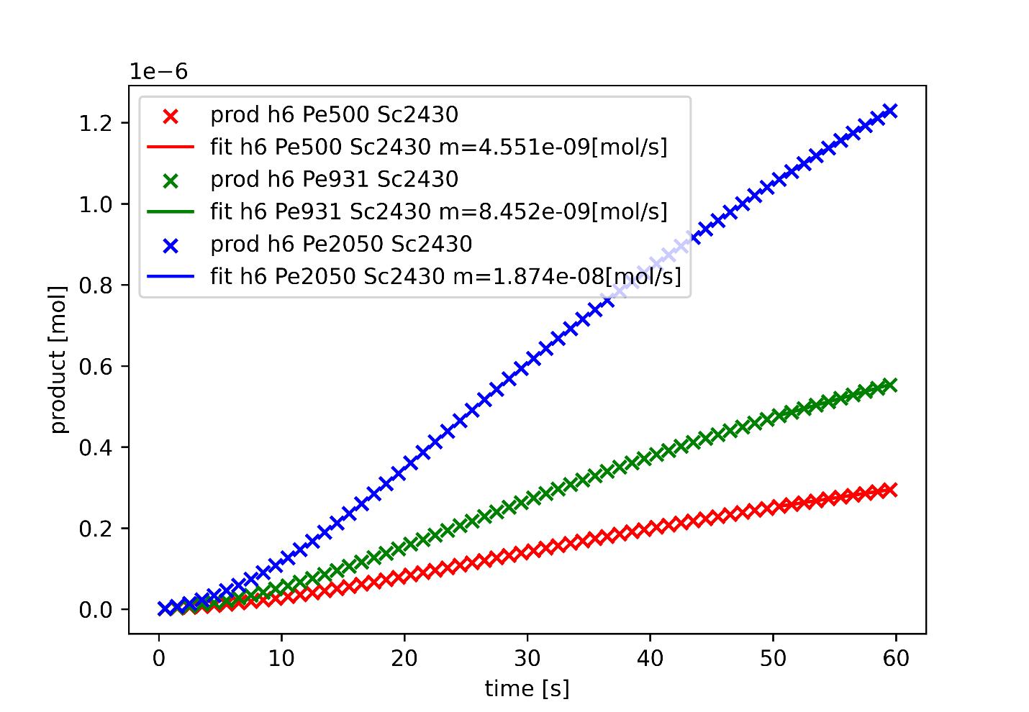
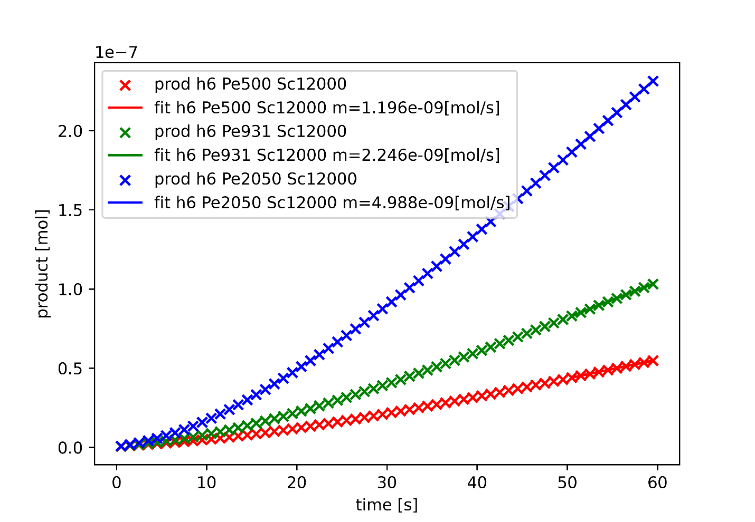
Total product formed h = 0.6mm

Slide 27
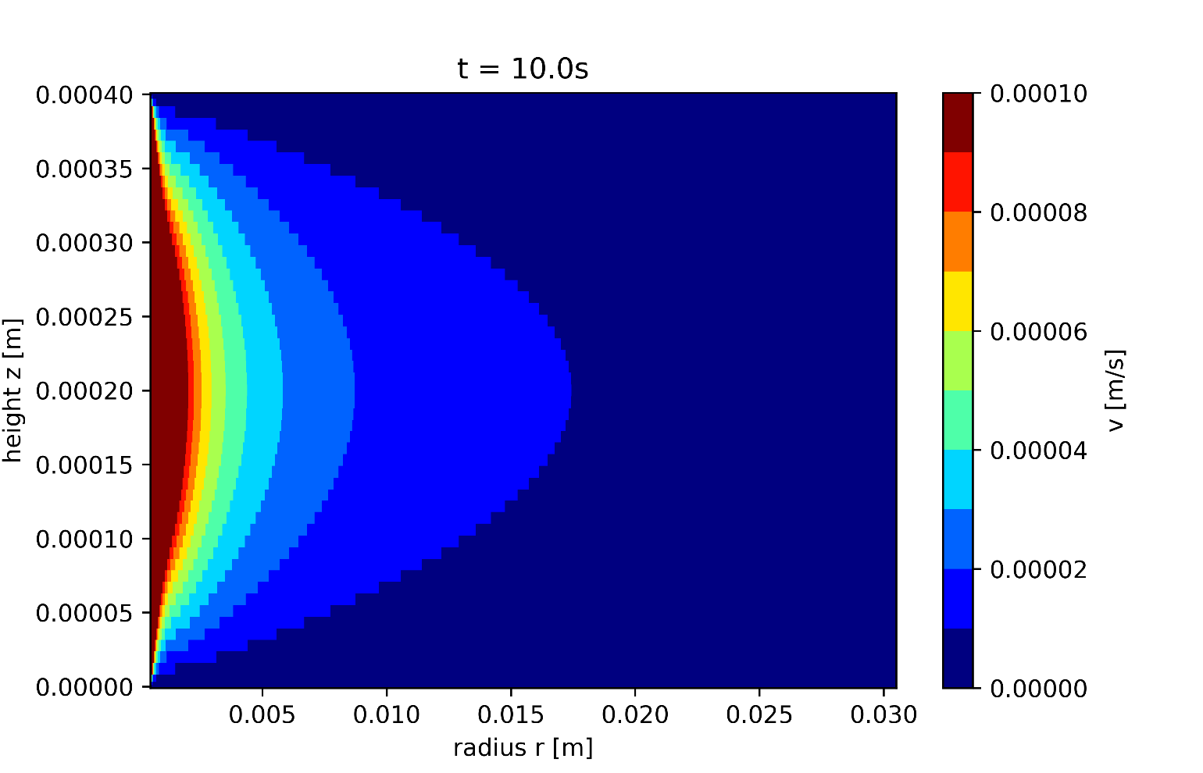
Velocity profile

Slide 28
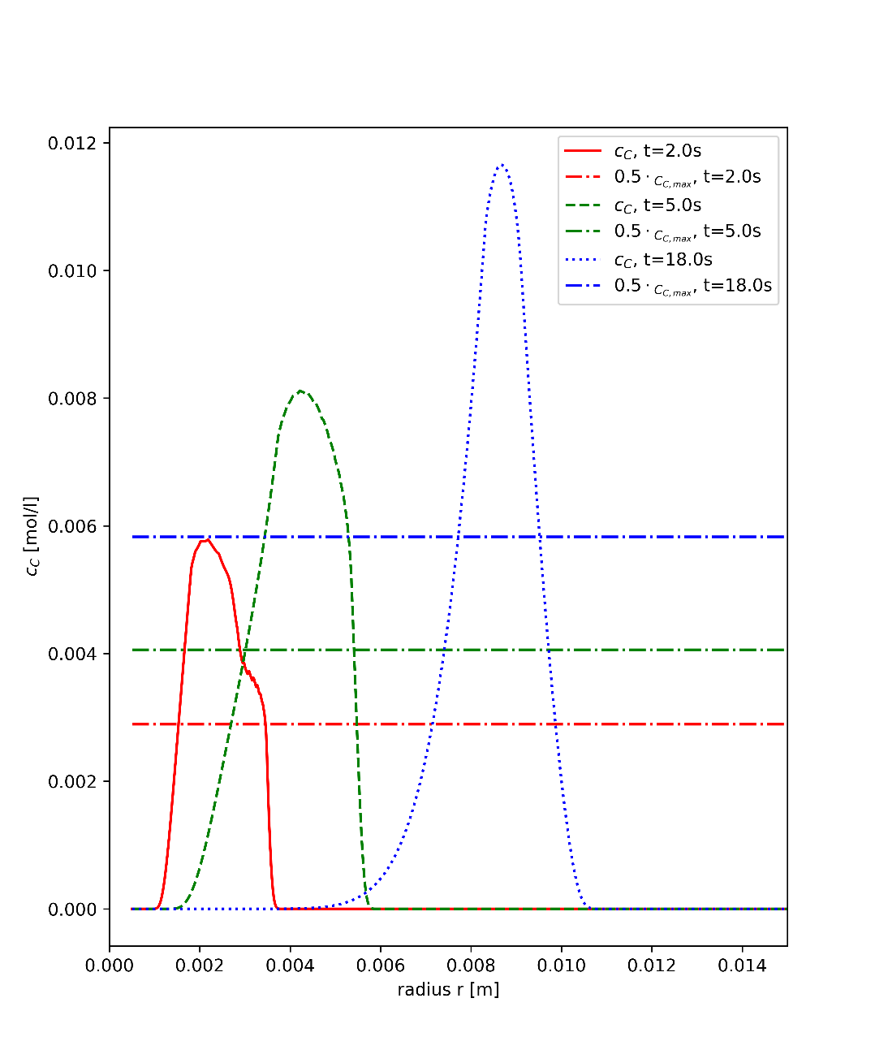
Width shrinkage

Slide 29
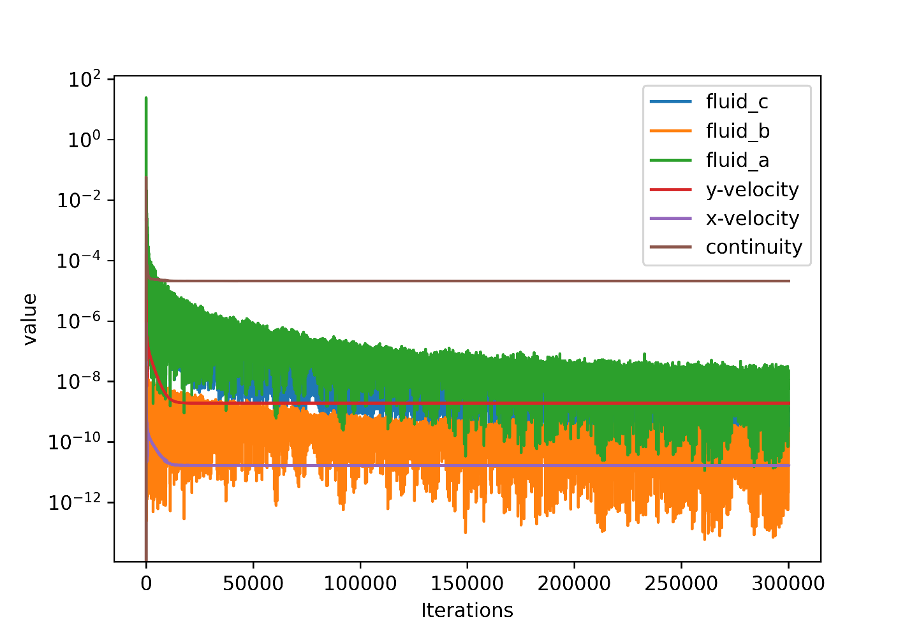
Residuals

Slide 30
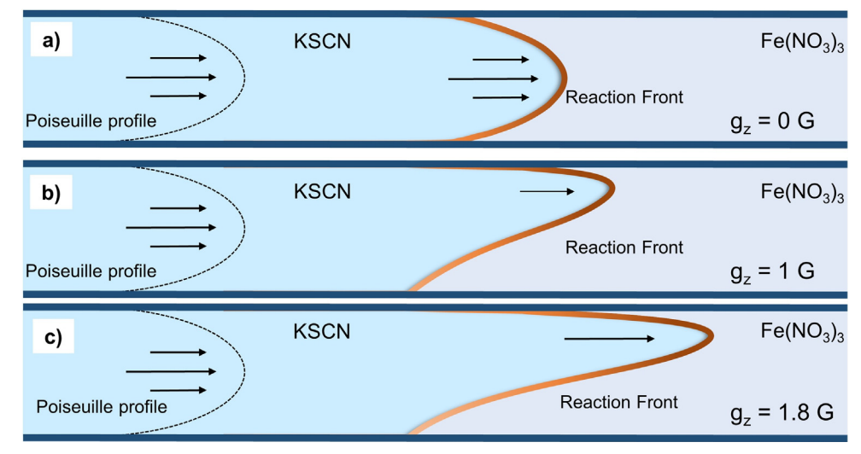
Gravitational influence

Slide 31
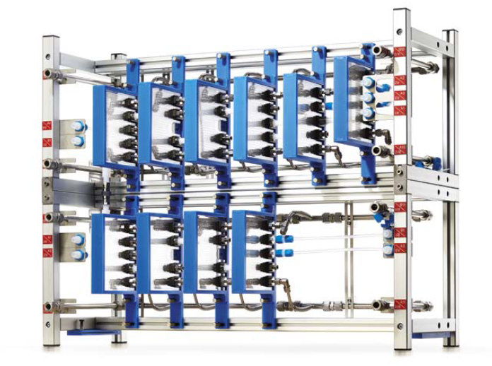
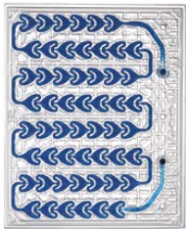
Microfluidic element
Microflow reactor

Slide 32

HPC Cluster

